Slide 1

Video Game Recommendation Expert System
Final Project Presentation Knowledge and Expert System
Presented By:
Rubab Saleem (100818564)
Poojan Patel (100799055)
Sachin Singh (100799069)

Slide 2
Introduction
A recommendation system is an intelligent agent that provides users with a list of suggestions based on the user’s profile
These models can offer new games to their users more personally, the production of new videogames also grows exponentially, to insert these new varieties to the market is necessary to calculate directly the target audience, minimizing loses.

Slide 3
Purpose of Expert System
We propose a videogame recommendation architecture and a recommendation system using Fuzzy Logic
We have designed 16 rules with fuzzy sets.
A database of approximately 55,000 games and of its 16 attributes of which 4 were used for the recommendation system was used:
Critic Score,
User Score,
Global_Sales,
Year of the game
Establish membership functions with the 16 rules of recommendation formed based on the opinion of experts in the field of videogame analysis

Slide 4
ARCHITECTURE AND RULES DESIGN
We design an architecture of a videogame recommendation system using fuzzy logic based on Critic Score, User Score, Global_Sales and Year, which are characteristics of a particular videogame of a user, in order to present a list of videogame titles that resemble your user tastes.

Slide 5
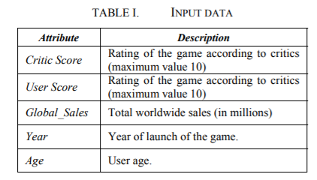
Data
A data set was obtained from the Kaggle page

Slide 6
Fuzzy sets and membership functions
The fuzzy set that we devised for the CRITIC SCORE variable has the range for qualification of [0,10]
The variable USER SCORE are scores that users use to rate the games are contained between the number 1 and 10, in this work we have considered those games below the rating 4.5 as “bad”, rates between 4.5 and 7.5 are considered “regular” and those rates greater than 7.5 are “good”.
YEAR OF LAUNCH of the game, this variable was collected from the IGN website
VIDEOGAME SALES are contained between the minimum amount of sales of the data set and their respective maximum normalized between [0,20], being those videogames that have sales below 10 considered as low and those over 10 were considered high.

Slide 7
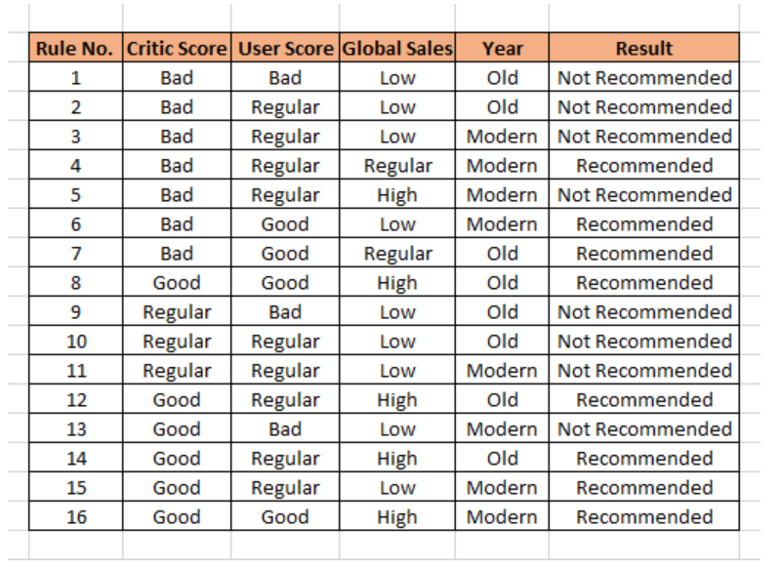
Design of inference rules

Slide 8
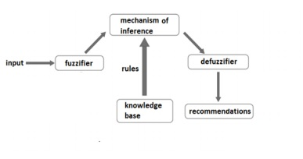
Proposed Architecture

Slide 9
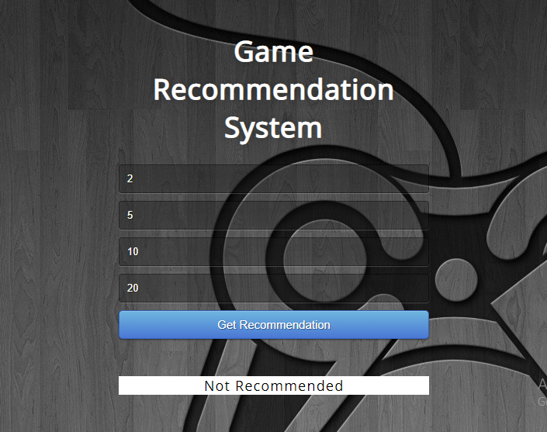
APPLICATION DESIGN
https://game-recommendation.herokuapp.com/
https://game-recommendation.herokuapp.com/

Slide 10
Knowledge Source and Acquisition
H. D. Calderon-Vilca, E. G. Ocrospoma-Callupe, F. C. CárdenasMariño and E. F. Calderon-Vilca, "Architecture and mobile application with augmented reality, visualizing videos and 3d objects in museums," 2019 IEEE CHILEAN Conference on Electrical, Electronics Engineering, Information and Communication Technologies (CHILECON), Valparaiso, Chile, 2019, pp. 1-5
H. Calderon-Vilca, U. Peruana De Ciencias, A. Lima, J. María, and R. Guimarey, “Recommendation of Videogames with Fuzzy Logic Nilton Mercado Chavez,.” Accessed: Aug. 03, 2021. [Online]. Available: https://fruct.org/publications/fruct27/files/Cal.pdf.
Segismundo S. Izquierdo and Luis R. Izquierdo, "Mamdani Fuzzy Systems for Modelling and Simulation: A Critical Assessment",Journal of Artificial Societies and Social Simulation 21(3) 2, 2018.
https://devcenter.heroku.com/articles/git

Slide 11
THANK YOU

